Slide 1


SOC Alert and Investigation with Wazuh
Funsho Igbasan

Slide 2
Task :
Run 3 attacks
1. Create a new user account
sudo useradd -m capstone_project && sudo passwd -d capstone_project
2. Execute a privileged command
sudo id
3. Modify the /etc/hosts file
sudo sh -c 'echo "# SOC-LAB" >> /etc/hosts'

Slide 3
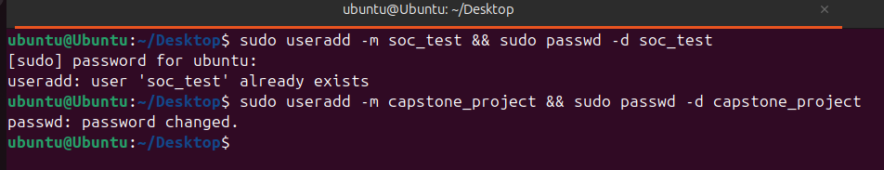
First Attack: Create a new user
Activity: sudo useradd -m capstone_project && sudo passwd -d capstone_project

Slide 4

New user added to the system
Timestamp: Oct 1, 2026 @ 20:05:21.687
Wazuh Rule ID: 5902
Wazuh rule description: New user added to the system.
Severity : 8
Agent: Ubuntu
User: capstone_project
Command/Event: New user account capstone_project added to the Ubuntu system
MITRE ATT&CK: T1136 Create Account
Finding : A new user account, capstone_project, was created on the Ubuntu system. This activity could be used by an attacker to establish a persistent unauthorized access for attacks.

Slide 5
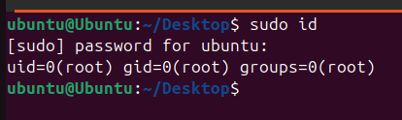
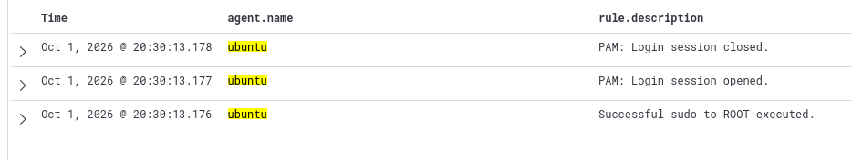
Second Attack: sudo id
Result: to check result, I went to Wazuh > Agent >Theat hunting> Events Discover > Explore

Slide 6
PAM: login session opened
Activity: sudo id
Timestamp: Oct 1, 2026 @20:30:13.177
Wazuh Rule ID: 5501
Wazuh rule description: PAM: login session opened
Severity : 3
Agent: Ubuntu
User: Ubuntu
Command/Event: sudo id command executed with elevated privileges
MITRE ATT&CK: T1078 Defense Evasion, Persistence, Privilege Escalation, Initial Access
Finding : A sudo session was opened for the Ubuntu account, allowing a command to execute with root privileges. Wazuh mapped this activity to Valid Accounts (T1078), which can be associated with unauthorized use of legitimate credentials for privileged access.

Slide 7
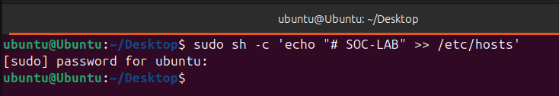
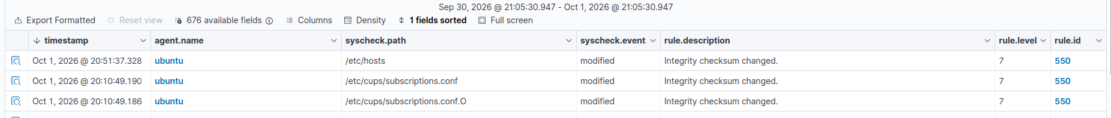
Third Attack: sudo sh -c 'echo "# SOC-LAB" >> /etc/hosts'
Result: To check result , Wazuh > file integrity monitoring > Events

Slide 8
Integrity checksum changed
Activity: sudo sh -c 'echo "# SOC-LAB" >> /etc/hosts'
Timestamp: Oct 1, 2026 @ 20:51:37.328
Wazuh Rule ID: 550
Wazuh rule description: Integrity checksum changed
Severity : 7
Agent: Ubuntu
User: Ubuntu
Command/Event: system integrity changed i.e /etc/hosts modified
MITRE ATT&CK: T1565.001 Stored Data Manipulation
Finding : The /etc/hosts system configuration file was modified, resulting in an integrity checksum change detected by Wazuh. Such unauthorized modification of system data could be used to alter system behavior or configuration.

